Slide 1


Performance Tools Update
Dan Burkland
Professional Services Consultant
Tech ONTAP – 2016-01-13 & 2016-01-14
Notes:
Start off with an intro about your background

Slide 2
Agenda
Current State
New Performance Monitoring Solution
Deployment
Examples
Review
Resources

Slide 3

State of the Union: Performance Tools
OnCommand Performance Manager (OPM)
Free yet powerful performance monitoring application
Deployed using OVA or via RPM
cDOT only
Root cause analysis along with a suggested action plan
Current version – 2.0
OnCommand Insight (OCI)
Complete storage resource management solution
Inventory discovery
Capacity & performance monitoring
Detailed root cause analysis and bottleneck detection
Compliance
Supports multiple storage vendors
Current Version – 7.1.2
Notes:
Summarize OPM & OCI, contrast the two
Explain experiences and where OPM comes up short

Slide 4
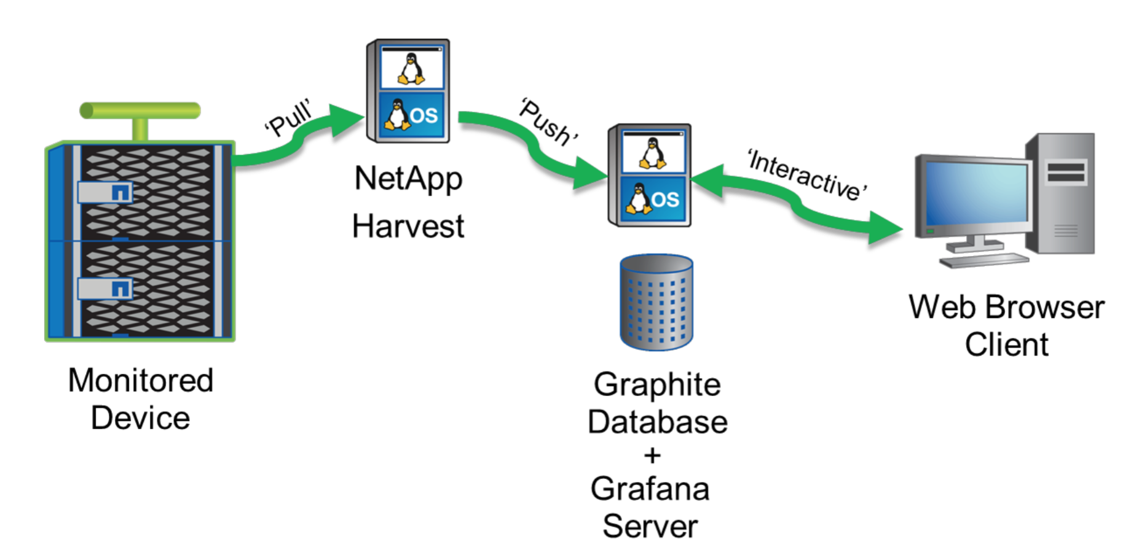
New Performance Monitoring Solution
NetApp Harvest
Perl-based application created by NetApp Enterprise Infrastructure Architect Christopher Madden
Collects data from 7mode/cDOT/OCUM 6.x systems on user-specified intervals
Relays data to time-series database (Graphite)
Data displayed using Grafana or another graphite-compatible dashboard solution
Notes:
Within the last calendar year a new performance monitoring solution exists which is known as NetApp Harvest.
NetApp Harvest is a Perl-based application written by a fellow NetApper that collects counter data from 7mode, cDOT, and OCUM systems and relays it to a time series database known as Graphite.

Slide 5
OPM 2.0 vs NetApp Harvest
 | OPM 2.0 | NetApp Harvest
Polling Interval | Every 5 minutes, hardcoded | 60 seconds, user configurable
Counter Inventory | 115 at most, 3 different presets | Flexible, roughly 500 counters, can be modified
Dashboards Provided | No | 19 Grafana dashboards, 500+ graph and singlestat panels
Support for 7mode | No | Yes
Storage Capacity Info | No | Yes through OCUM 6.x
Ease of Use | Deployable via OVA or RPM, configured through web interface | Deployed from zip file, configured via text file**
Supported By | NetApp Support | Community via communities.netapp.com
Licensing | Free | Free, Open Source
Source: Placeholder
Notes:
Mention how there is a new deployment method for NetApp Harvest which again will be covered in the coming slides

Slide 6
Deployment

Slide 7
Basic Deploymenet Walkthrough
Part 1 – Prerequisites
Prereqs
Linux Server (physical or virtual)
CPU: 1 CPU
RAM: 4 GB
HDD: root (OS) filesystem – 20 GB+, /opt/data filesystem – 100GB+
Network: Outbound ftp/http/https access
Distribution: CentOS or RHEL is preferred
Access: direct or sudo-based root access to the aforementioned Linux system
Notes:
While cDOT 8.2.1 will work it is recommended to use at least cDOT 8.2.2P2 for performance and stability reasons. If possible use cDOT 8.3 due to all of the new functionality introduced in the 8.3 codeline.

Slide 8
Basic Deploymenet Walkthrough
Part 2 – Data Filesystem Setup
Prereqs
Linux Server (physical or virtual)
CPU: 1 CPU
RAM: 4 GB
HDD: root (OS) file system – 20 GB+, /opt/data file system – 100GB+
Network: Outbound ftp/http/https access
Distribution: CentOS or RHEL is preferred
Access: direct or sudo-based root access to the aforementioned Linux system
Data Filesystem Setup
Notes:
While cDOT 8.2.1 will work it is recommended to use at least cDOT 8.2.2P2 for performance and stability reasons. If possible use cDOT 8.3 due to all of the new functionality introduced in the 8.3 codeline.

Slide 9
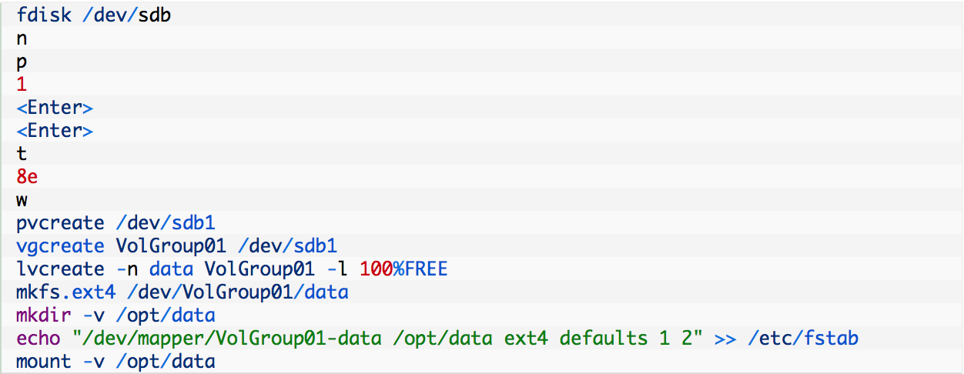
Basic Implementation Walkthrough
Part 2 – Data Filesystem Setup (Cont.)

Slide 10
Basic Deploymenet Walkthrough
Part 3 – Install & Start Docker
Prereqs
Linux Server (physical or virtual)
CPU: 1 CPU
RAM: 4 GB
HDD: root (OS) file system – 20 GB+, /opt/data file system – 100GB+
Network: Outbound ftp/http/https access
Distribution: CentOS or RHEL is preferred
Access: direct or sudo-based root access to the aforementioned Linux system
Data Filesystem Setup
Install & Start Docker
Notes:
While cDOT 8.2.1 will work it is recommended to use at least cDOT 8.2.2P2 for performance and stability reasons. If possible use cDOT 8.3 due to all of the new functionality introduced in the 8.3 codeline.

Slide 11
Basic Implementation Walkthrough
Part 3 – Install & Start Docker (Cont.)
CentOS/RHEL 6.7+
CentOS 7.0+
Red Hat Enterprise Linux (RHEL) 7.0
Other Distributions
See here

Slide 12
Basic Deploymenet Walkthrough
Part 4 – Build & Deploy The NetApp Harvest Container
Prereqs
Linux Server (physical or virtual)
CPU: 1 CPU
RAM: 4 GB
HDD: root (OS) file system – 20 GB+, /opt/data file system – 100GB+
Network: Outbound ftp/http/https access
Distribution: CentOS or RHEL is preferred
Access: direct or sudo-based root access to the aforementioned Linux system
Data Filesystem Setup
Install & Start Docker
Build the NetApp Harvest container
Notes:
While cDOT 8.2.1 will work it is recommended to use at least cDOT 8.2.2P2 for performance and stability reasons. If possible use cDOT 8.3 due to all of the new functionality introduced in the 8.3 codeline.

Slide 13
Basic Implementation Walkthrough
Part 4 – Build & Deploy The NetApp Harvest Container (Cont.)
Download the following files to your workstation and upload them to “/root/docker/harvest” on the Docker host server
bashrc
Dockerfile
grafana_graphite_harvest_silent.sh
mysql_silent.sh
netapp_harvest_automated_setup
proxy_enable.sh
netapp-harvest-1.2.2.zip
netapp-manageability-sdk-5.4P1.zip
netapp-harvest-grafana-2.5.zip
Allow execution of recently downloaded scripts

Slide 14
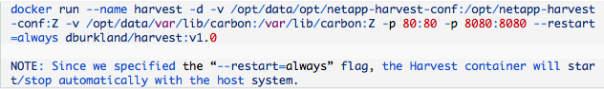
Basic Implementation Walkthrough
Part 4 – Build & Deploy The NetApp Harvest Container (Cont.)
Build the Harvest Docker image
Deploy a new container using the new Docker image

Slide 15
Basic Deploymenet Walkthrough
Part 5 – Final Setup Steps
Prereqs
Linux Server (physical or virtual)
CPU: 1 CPU
RAM: 4 GB
HDD: root (OS) file system – 20 GB+, /opt/data file system – 100GB+
Network: Outbound ftp/http/https access
Distribution: CentOS or RHEL is preferred
Access: direct or sudo-based root access to the aforementioned Linux system
Data Filesystem Setup
Install & Start Docker
Build the NetApp Harvest container
Final Setup Steps

Slide 16
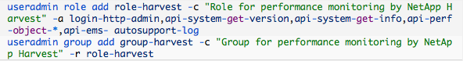
Basic Implementation Walkthrough
Part 5 – Final Setup Steps
Create the Harvest user accont & role on each NetApp system you wish to monitor
7mode

Slide 17
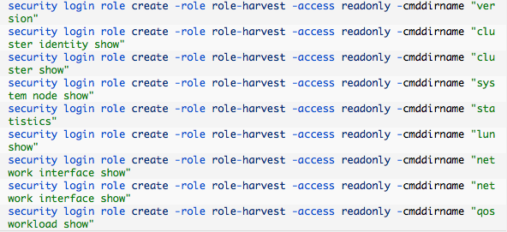
Basic Implementation Walkthrough
Part 5 – Final Setup Steps (Cont.)
Create the Harvest user accont & role on each NetApp system you wish to monitor
cDOT

Slide 18
Basic Implementation Walkthrough
Part 5 – Final Setup Steps (Cont.)
Create the Harvest user accont & role on each NetApp system you wish to monitor
cDOT 8.2.x or earlier
cDOT 8.3 or newer
Define all applicable NetApp systems in Harvest configuration file “/opt/data/opt/netapp-harvest-conf/netapp-harvest.conf”
7mode controller or cDOT cluster

Slide 19

Basic Implementation Walkthrough
Part 5 – Final Setup Steps (Cont.)
Login to the container and apply the final setup changes by restarting the Harvest service

Slide 20
Examples

Slide 21
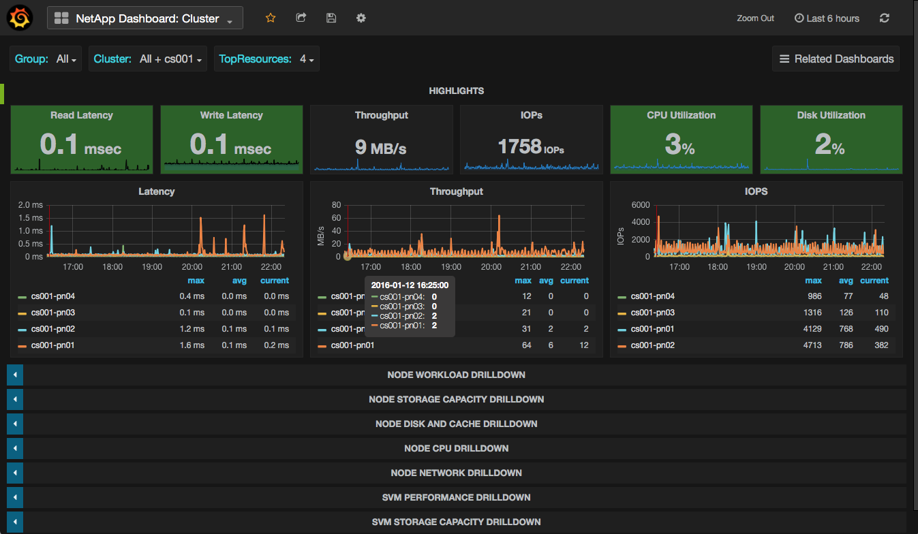
Examples
Part 1 - Cluster Dashboard

Slide 22
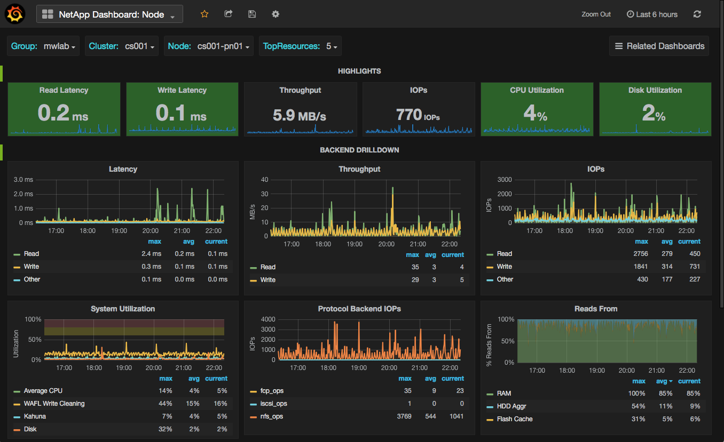
Examples
Part 2 – Node Dashboard

Slide 23
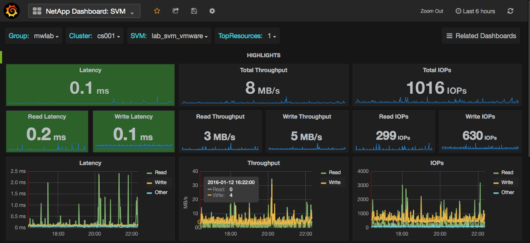
Examples
Part 3 – SVM Dashboard

Slide 24
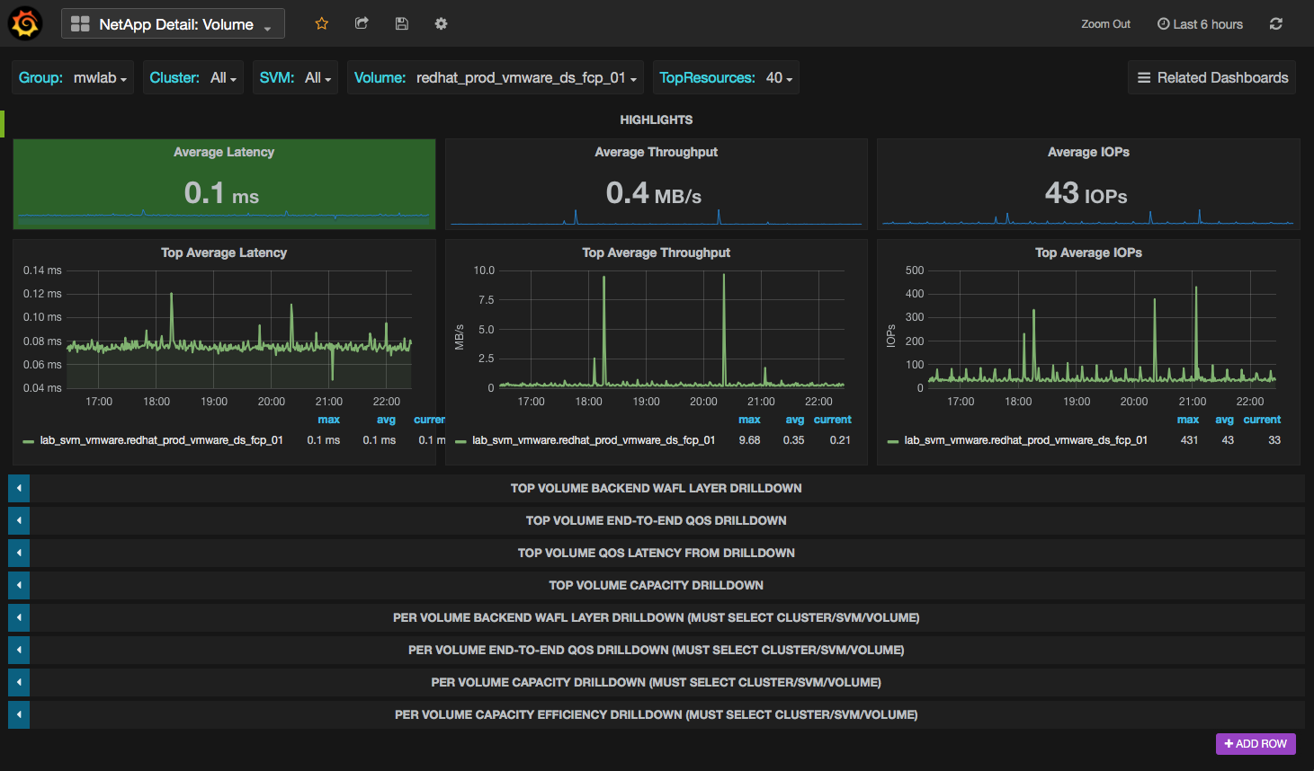
Examples
Part 4 – Volume Dashboard

Slide 25
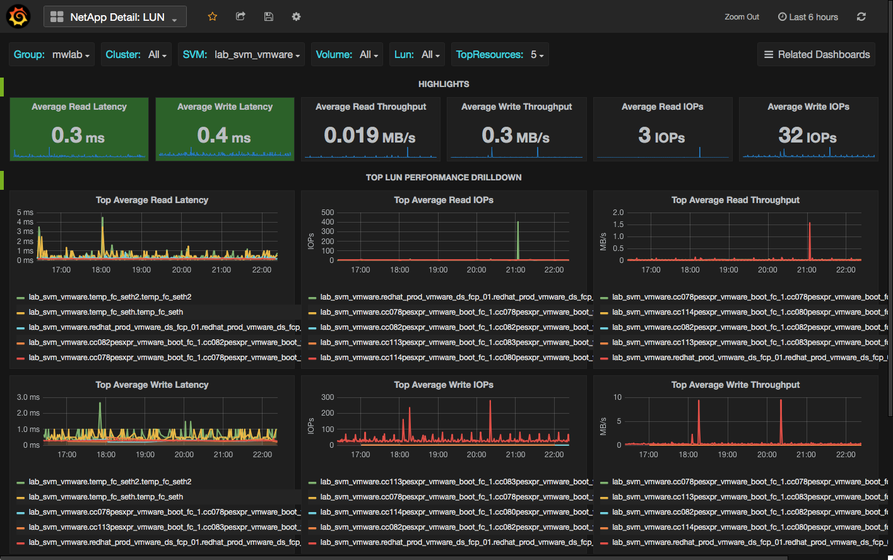
Examples
Part 5 – LUN Dashboard

Slide 26
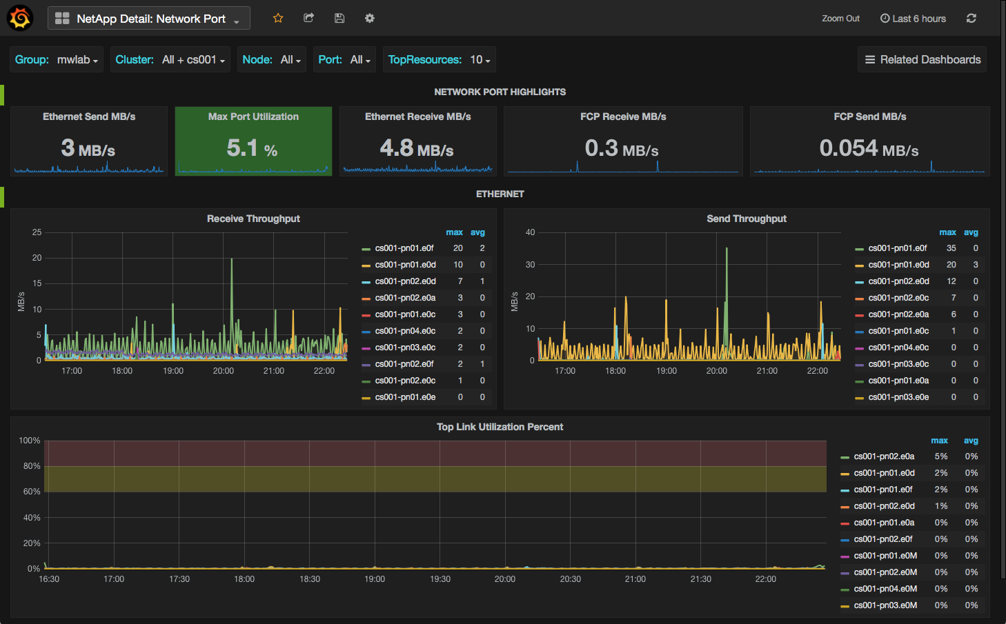
Examples
Part 6 – Network Port Dashboard

Slide 27
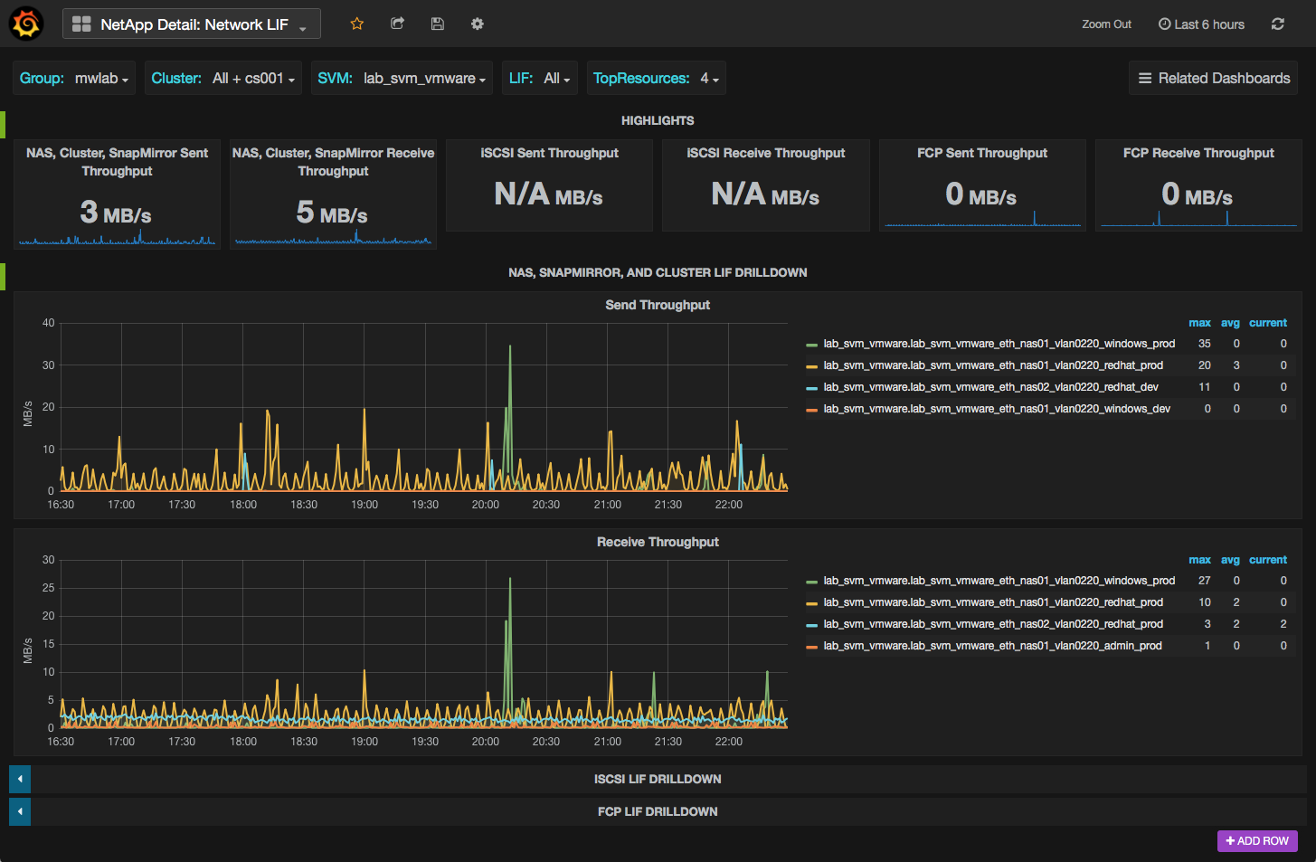
Examples
Part 7 – LIF Dashboard

Slide 28

Review
OPM is designed for detection and alerting on most common performance issues
For deeper investigation, use NetApp Harvest
19 dashboards with ability to customize
500+ counters
Built on open source technologies
Free: $0
Designed with scale in mind

Slide 29
Resources
How To Setup NetApp Harvest Using Docker
Sources
[GitHub] dburkland/harvest Repository
NetApp Harvest Installation and Administration Guide
Christopher Madden’s Blog
2258-3: Real-time Monitoring of Clustered Data ONTAP
[DBurkland.com] How To Setup Graphite To Visualize OnCommand Performance Manager Data
[DBurkland.com] How To Setup Grafana with Graphite And Create Basic Dashboards
What is Docker?
Docker Volumes Using NetApp Storage
Myself
www.dburkland.com
Twitter: @dburkland

Slide 30
Thank you

Slide 31

Other Tidbits
When NAS vols are moved, VVols are rebound to now local PEs
Snapshots
Snapshots offloaded to backend array
Cloning/Migration (SvMotion)
VASA API offloads always tried first
If VASA APIs are not available or supported, a host-orchestrated clone is then attempted (VAAI)
If VAAI functionality is not available or supported, the legacy software data mover (host based copy process) is utilized
State of VM matters
Presence of snapshots also matters
Notes:
This first tidbit is important as it ensures direct access to storage at all times (even when storage is moved between nodes on the backend for example)
Snapshots of VVols are now offloaded to the backend array. Since the “base” VMDK file is essentially cloned when each snapshot is created, the current base VMDK never changes. This means when a “consolidate” operation is performed the clones (or Point-in-time copies) are deleted (rather than merged with the base version like in previous versions of vSphere)
In regards to the third item, VASA APIs are at minimum used to create a bitmap of only the relevant blocks that need to be migrated (space efficiency). If the VM is powered off the “cloneVirtualVolume” VASA API will be used to migrate the VM otherwise the VAAI functionality will be attempted (note legacy method will be used for running NAS VMs).
If the VM has snapshots present and is running on a NAS VVol datastore, the “copyDiffsToVirtualVolume” and “cloneVirtualVolume” VASA APIs will be utilized to migrate snapshots.

Slide 32
VVol Types
Type | Block | NFS | Notes
Config | LUN, 4GB | Directory | VMX, logs
Data | LUN, size of virtual disk | File, size of virtual disk | Virtual Disk
Swap | LUN, size of virtual memory* | File, size of virtual memory* | Created when VM powered on
Memory | LUN, size of virtual memory | File, size of virtual memory | Memory snapshot
Other | Depends on use case | Depends on use case | VMware HA datastore heartbeat (4GB LUN or NFS directory)
Source: Placeholder
Notes:
You could argue that a VMware HA datastore heartbeat is really a config VVol, but I haven’t seen it spelled out in any VMware docs.
Each can have a different VM Storage Policy and end up in a different volume or datastore. Exception is swap, which goes in the volume defined by the default storage policy of the selected datastore.

Slide 33
VVol LUN Binding To PE
cs001::*> lun bind show -vserver lab_svm_vmware -instance
Vserver Name: lab_svm_vmware
PE MSID: 2147488008
PE Vdisk ID: 800011080000000000000000000000600358eebb
VVol MSID: 2147488008
VVol Vdisk ID: 80001108000000000000000000000065035930a0
Vserver UUID: a287ac6f-8316-11e4-ba50-00a0982e2790Protocol
Endpoint: /vol/testing_dev_vmware_VVol_fcp_01/VVolPE-1427684989046
PE Node: cs001-pn01
VVol:/vol/testing_dev_vmware_VVol_fcp_01/naa.600a098051757a633524466356544648.vmdk
VVol Node: cs001-pn01
Secondary LUN: d2514a000000
Optimal binding: true
Reference Count: 1
Notes:
To visualize what VVOL LUNs look like from Clustered Data ONTAP, let’s take a look at the new “lun bind show” command which is visible in the advanced privilege mode.
The top error shows the name of teh
Notice that in this command you can see which VVol LUNs are bound to this PE LUN

Slide 34
Protocol Endpoints and LUN Mapping
cs001::*> lun mapping show -vserver lab_svm_vmware -volume testing_dev*
Vserver Path Igroup LUN ID Protocol
-------- ----------------------------- ------------- ------ --------
lab_svm_vmware /vol/testing_dev_vmware_VVol_fcp_01/VVolPE-1427684989046 VVol-igroup-1 fcp 300
One PE per FlexVol used in a VVol datastore
PEs and initiator group created and managed by VP
LUN IDs starting at 300

Slide 35



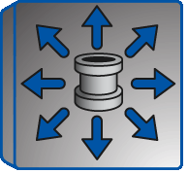

VVol Datastore Layout
SVM
FlexVol Volumes
Storage Network
ESXi
Notes:
Things to notice, green cylinder represents FlexVols which contain multiple VVols. Coming slide will better depict the differenc

Slide 36
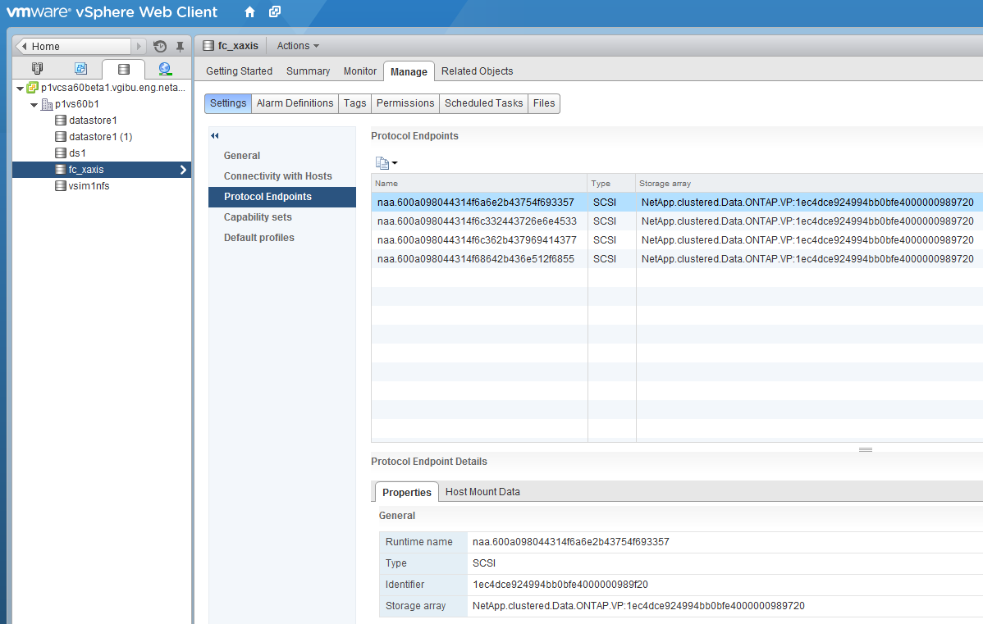
vCenter / ESXi View of PEs

Slide 37
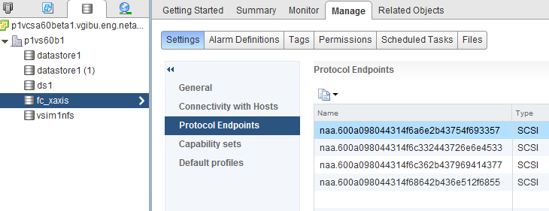
vCenter / ESXi View of PEs

Slide 38
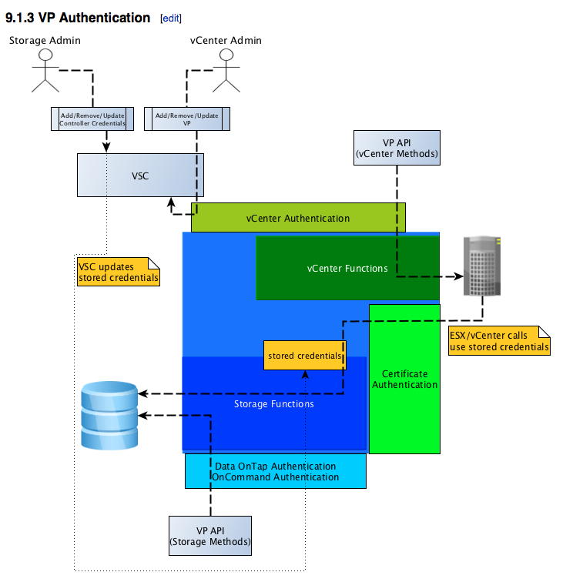
VP Authentication
Notes:
While cDOT 8.2.1 will work it is recommended to use at least cDOT 8.2.2P2 for performance and stability reasons. If possible use cDOT 8.3 due to all of the new functionality introduced in the 8.3 codeline.

Slide 39

Beta Testing and General Learning Tips
Get the beta – try it out
Use Vsim and nested ESXi if you don’t have hardware
Get used to Web client – explore – learn
Use the cookbook
Try different SCPs, VM storage policies
Explore under the covers
ESXi /vmfs/volumes
LUN commands in ClusterShell
VP web interface http://VP_IP:9080

